Slide 1

CSE-5335: Presentation
Rakesh Sharma Kolavennu
Siva Sri Harsha Suthapalli
Sai Sharath Reddy Koppula
Seshu Babu Padavala
Hari Kiran Goud Ediga
Section: 5335-002
Fall 2023

Slide 2

Pages before Login

Slide 3
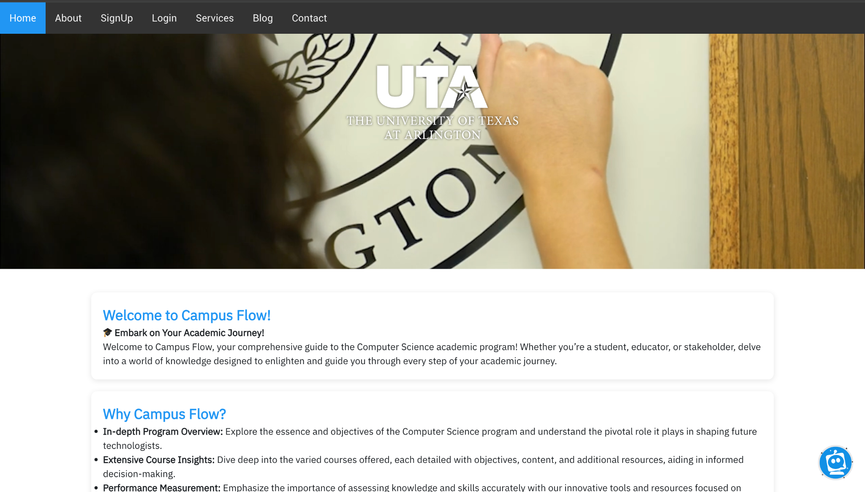
Home Page

Slide 4
HomeScreen: Your First Step into Campus Flow
Welcoming Interface, Engaging Experience:
Central Gateway
User-Friendly Navigation
Engaging Visuals
Information at a Glance
Intuitive Layout.
Connect and Explore
Designed for the Campus Community

Slide 5
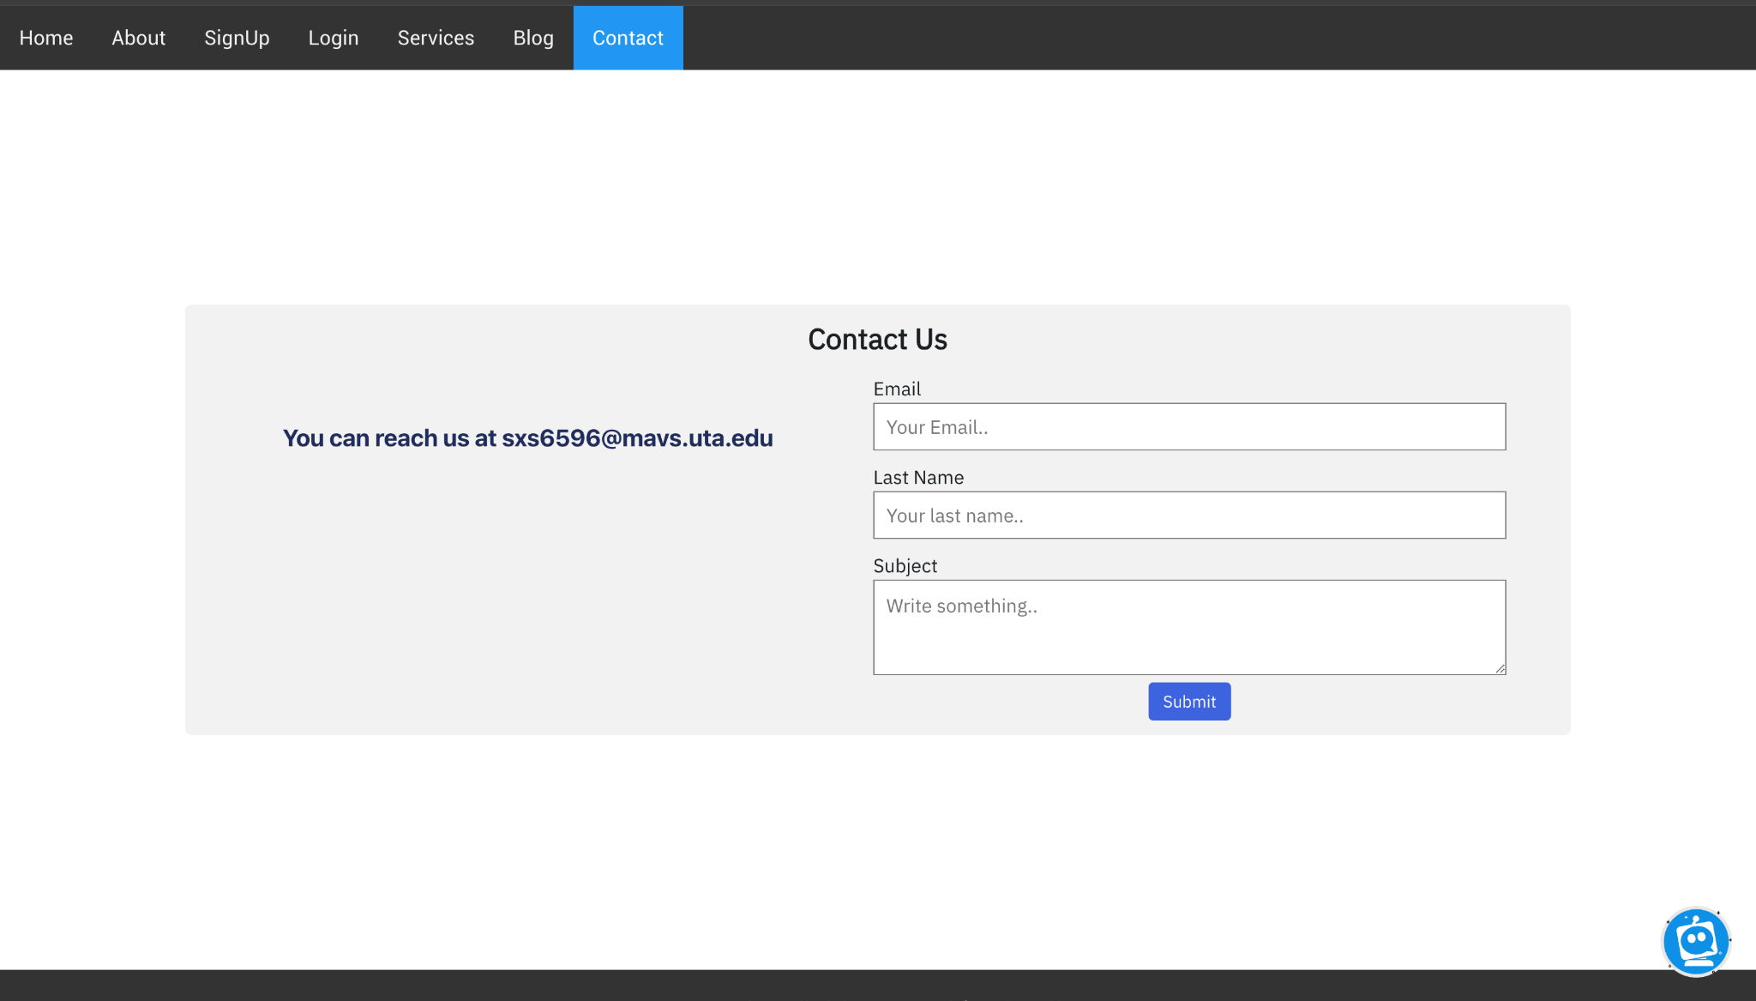
Contact Us

Slide 6
Campus Flow's Contact Page with Chatbot Integration:
Interactive Contact Platform
Chatbot Assistant
User-Friendly Form Submission
Seamless Integration

Slide 7
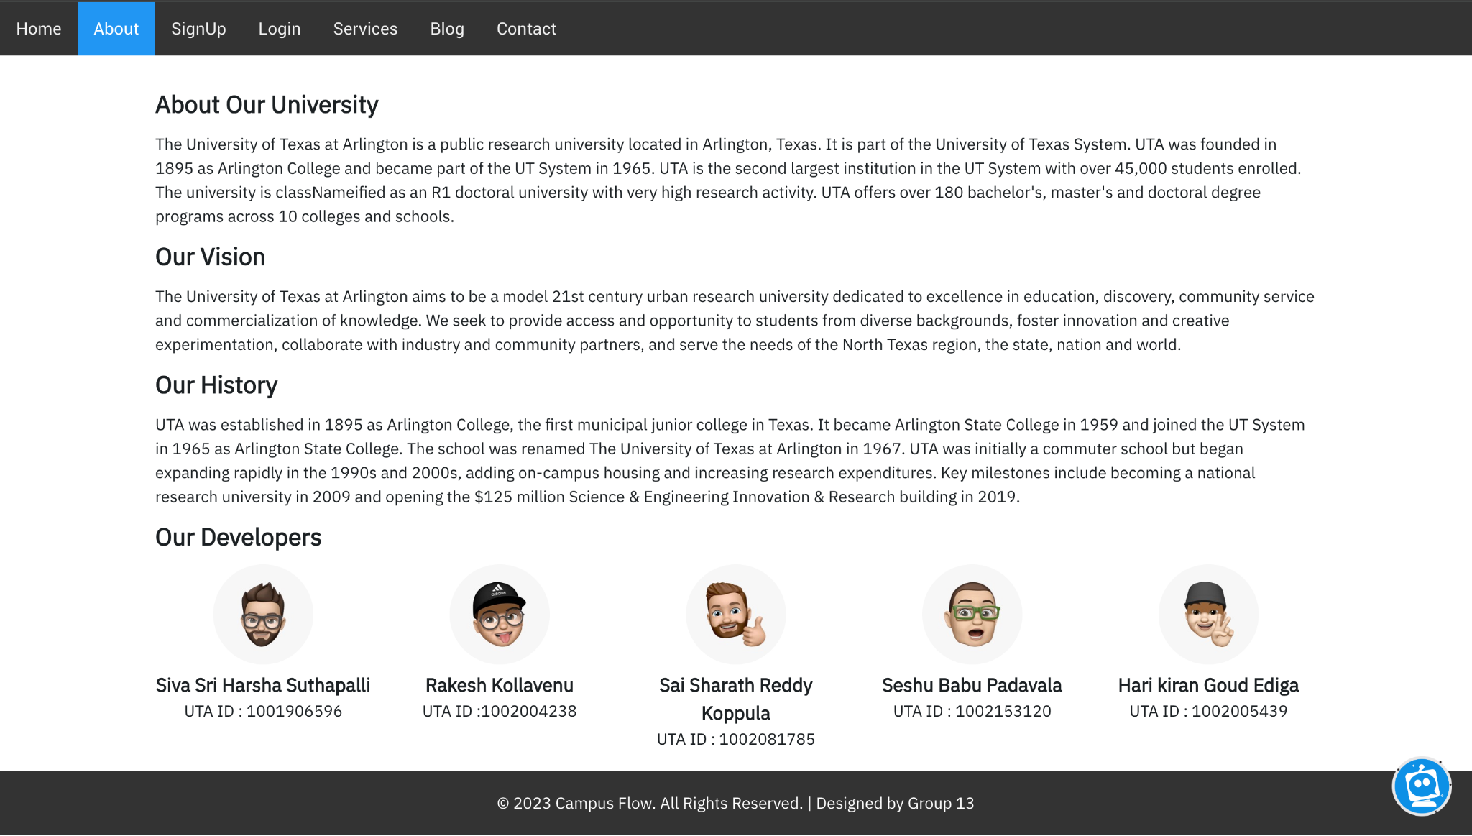
About

Slide 8
Login Landing

Slide 9
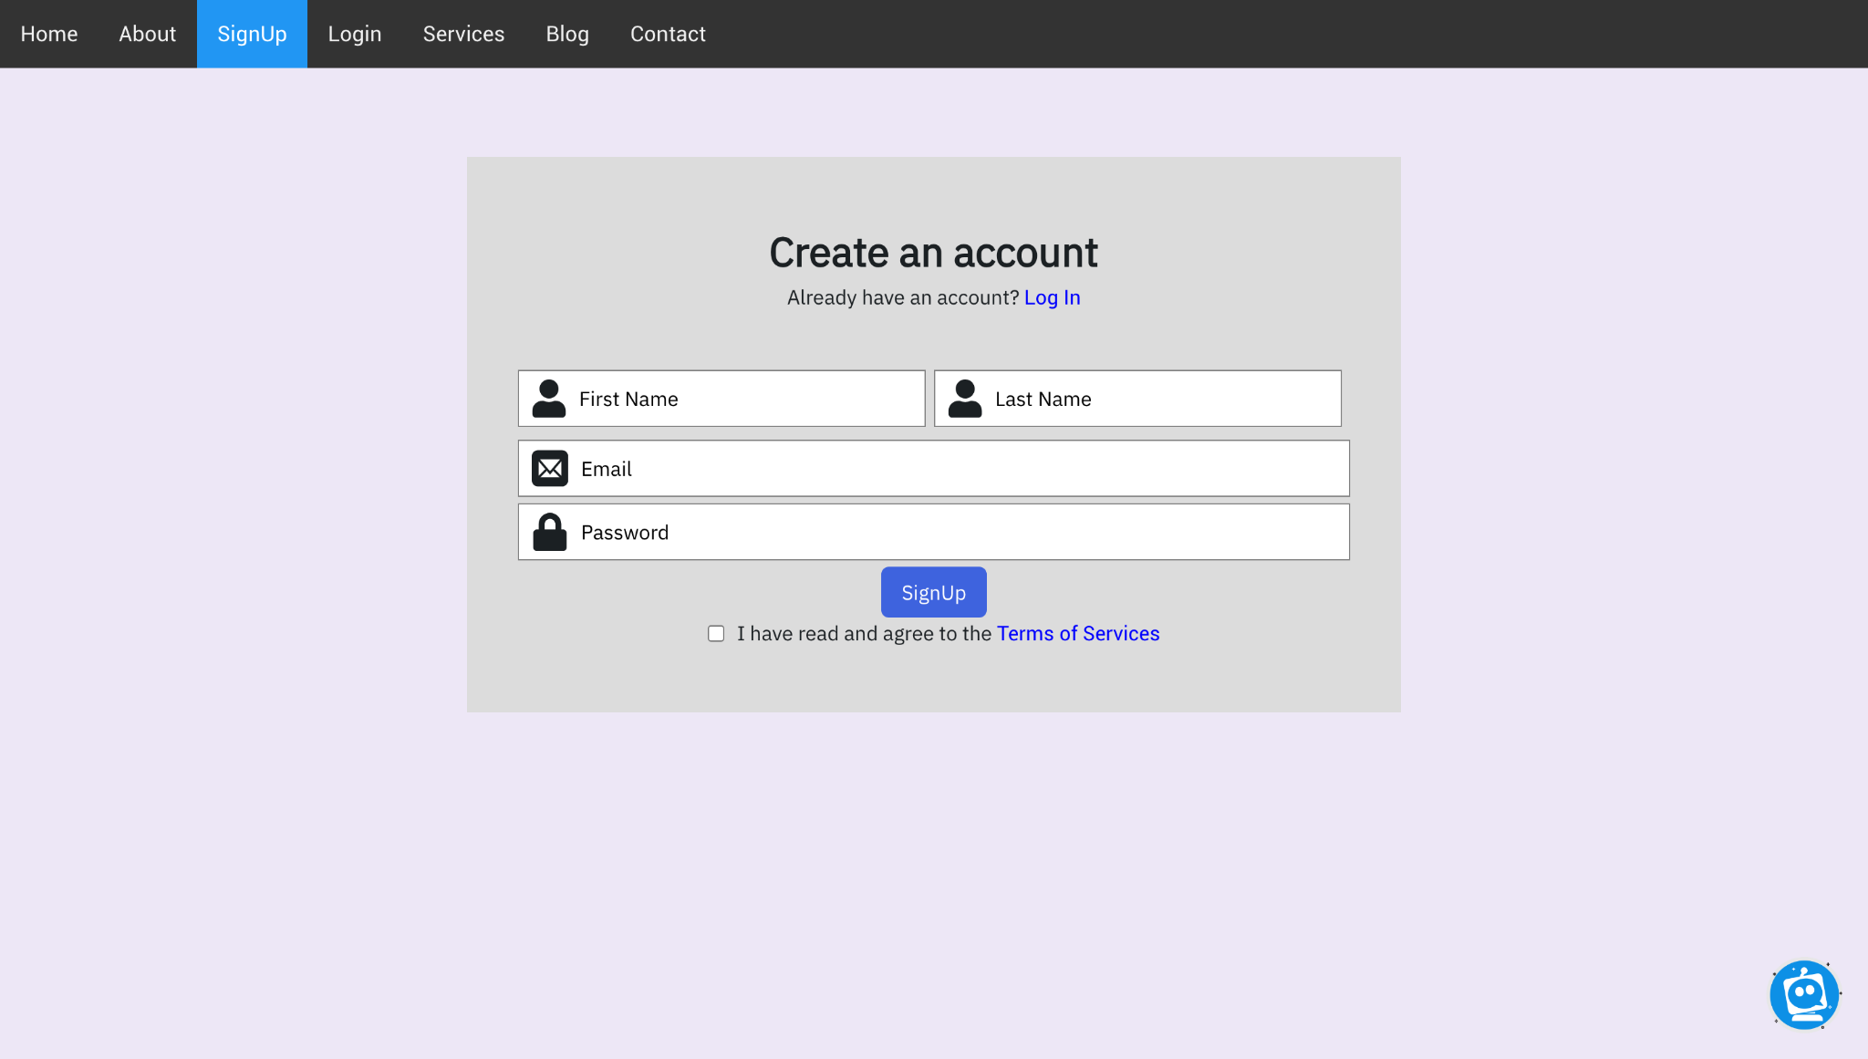
sign up

Slide 10
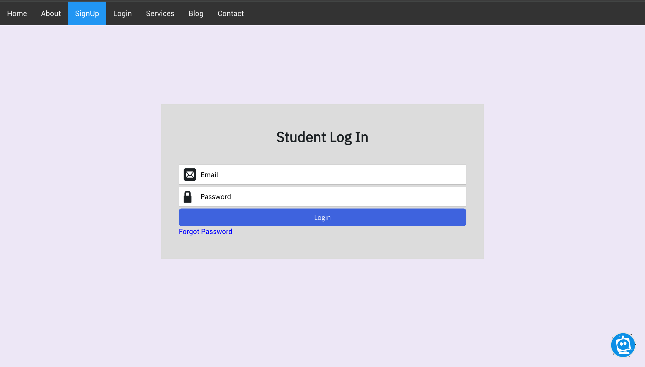
Login

Slide 11
Pages after Login

Slide 12
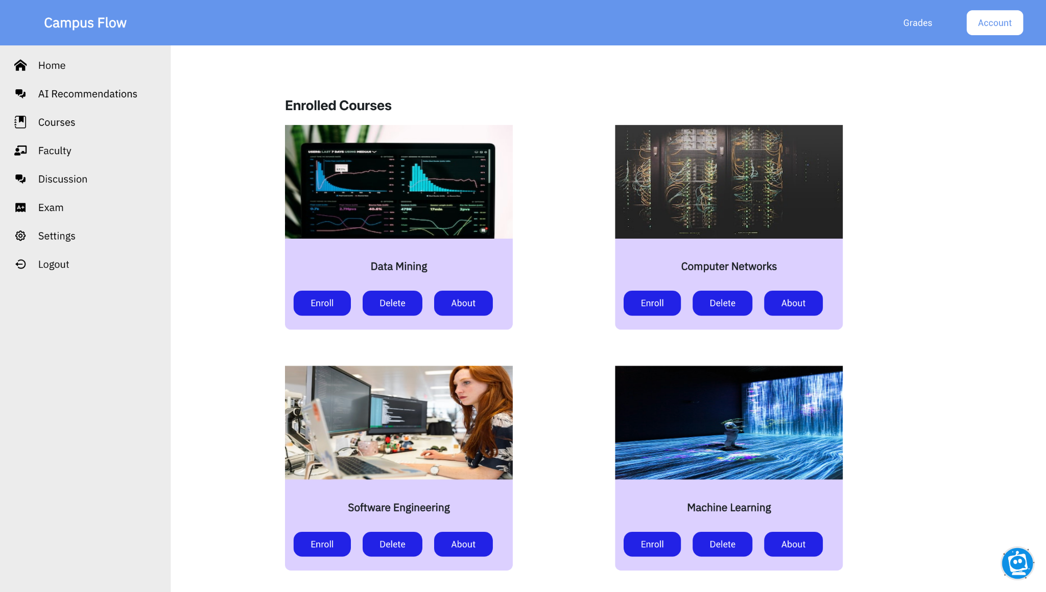
Student Dashboard

Slide 13
Campus Flow Student Portal: Navigating Academic and Community Interactions
Enrolled Courses and Academic History
Interactive Chatbot for Community Engagement
Personal Profile Access
Settings for Personalization

Slide 14
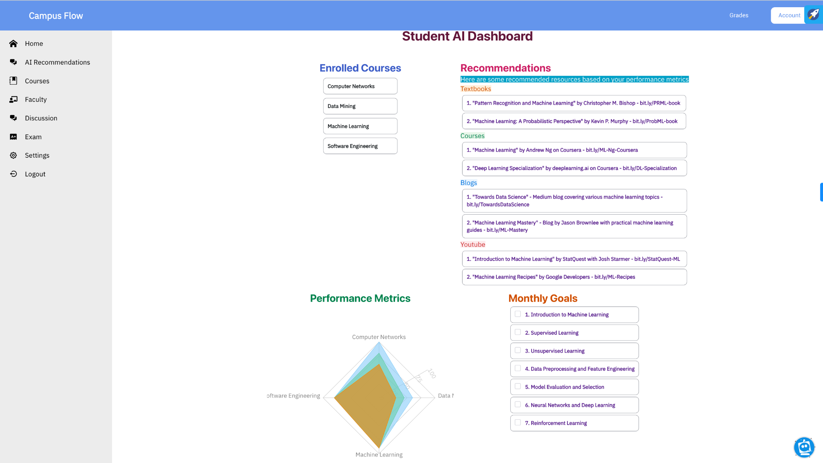
Student AI Dashboard

Slide 15
Smart Recommendations for Enhanced Learning
Enrolled Courses Overview
Performance Metrics Analysis
Customized Recommendations
Scheduled Tasks for Improvement

Slide 16
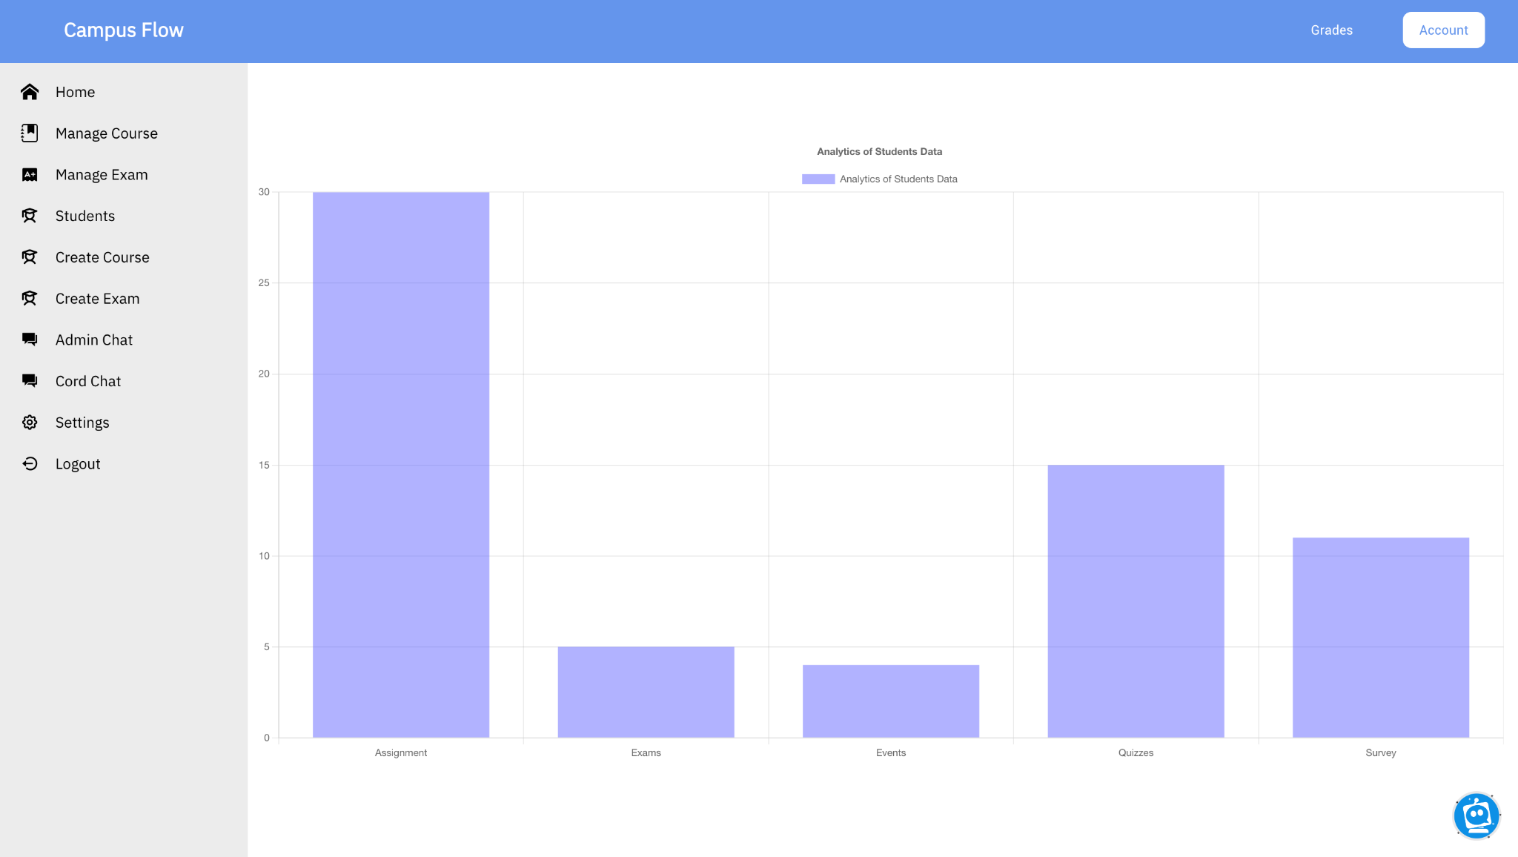
Faculty Dashboard

Slide 17
Empowering Educators: The Faculty Page in Campus Flow
Course Creation and Management
Automated Exam Creation and Administration
Student Performance Tracking
Grade Updating and Analysis
AI Implementation in Assessments

Slide 18
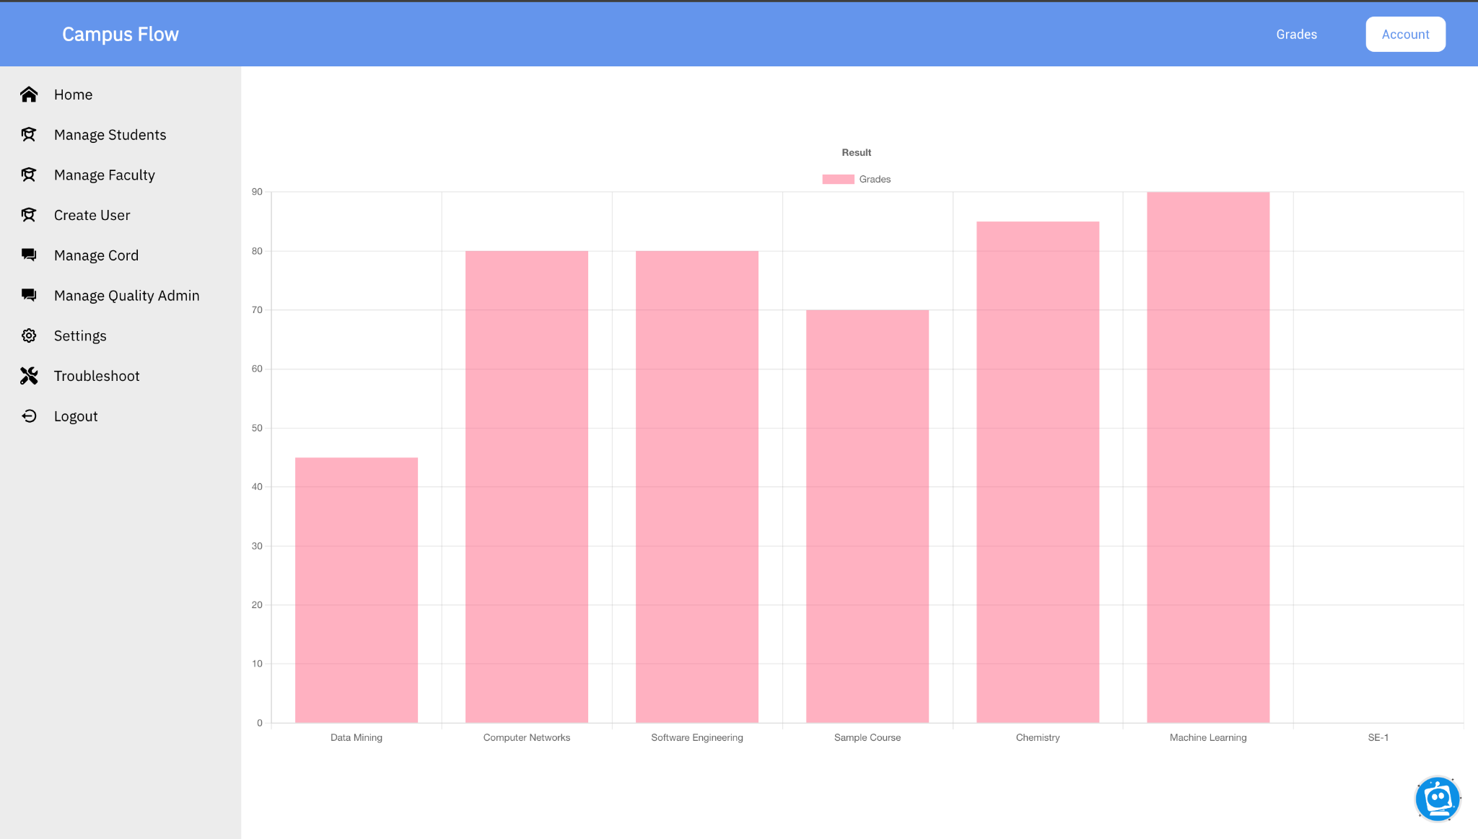
Admin Dashboard

Slide 19
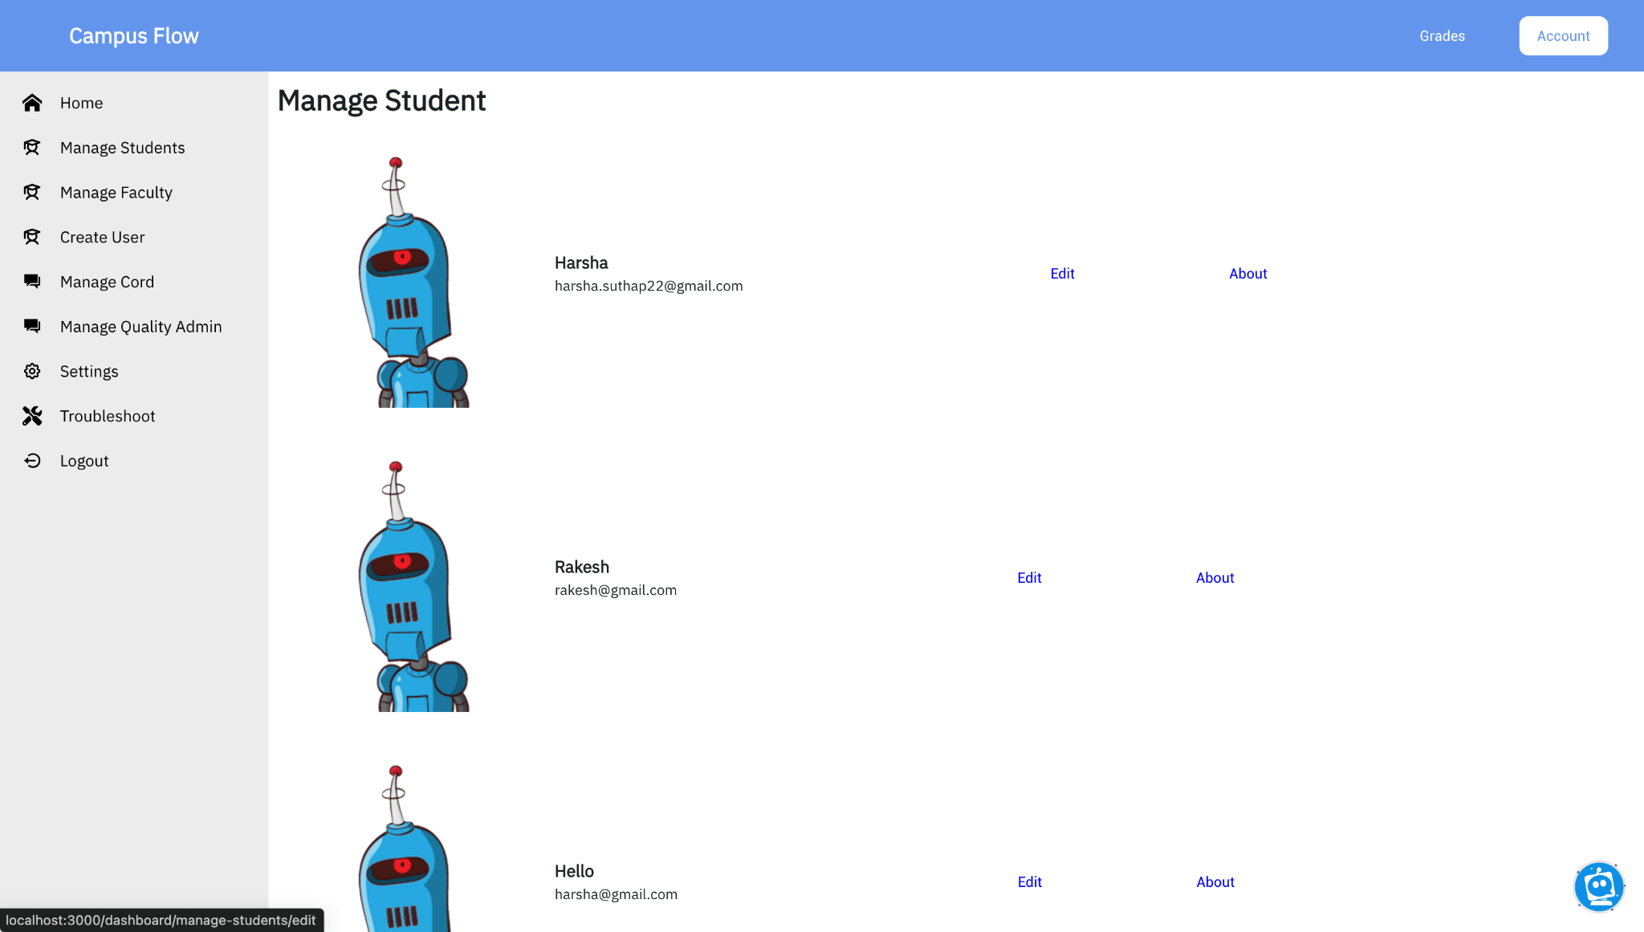
Manage Student

Slide 20
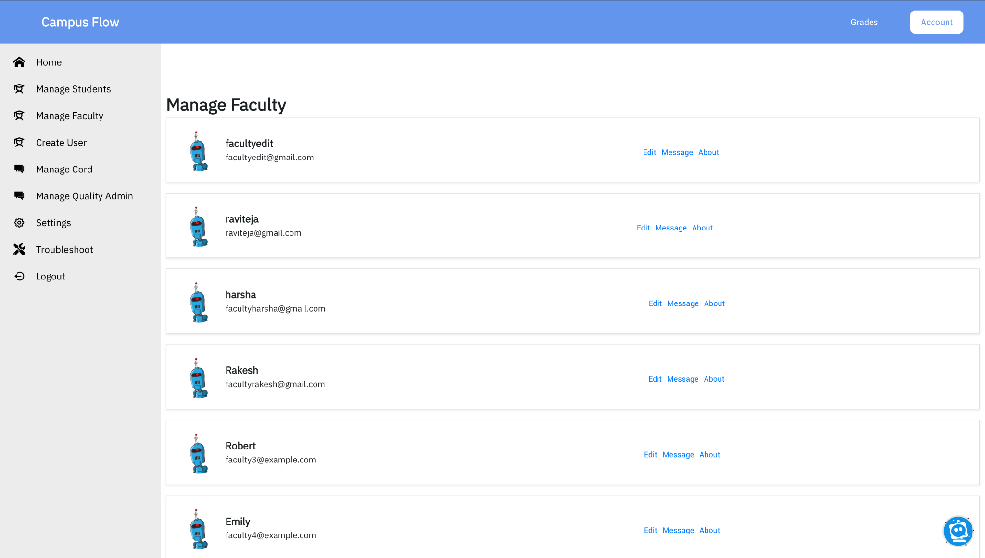
Manage Faculty

Slide 21
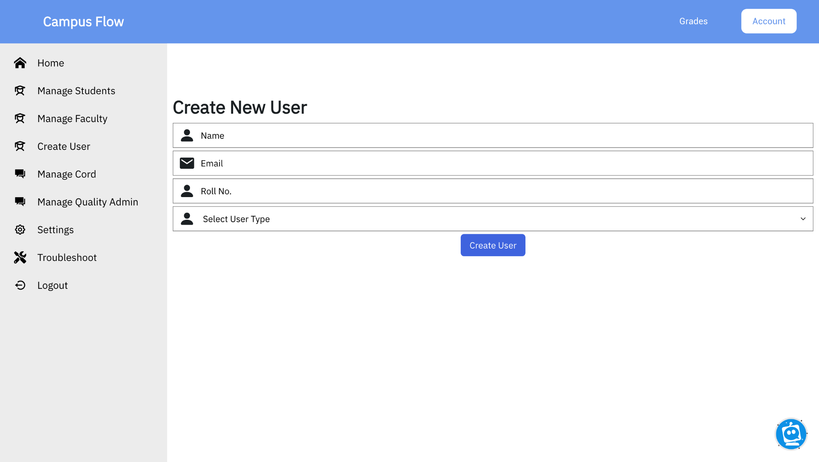
Create User

Slide 22
Admin Page: The Control Center of Campus Flow
Comprehensive User Management
User Details Modification and Oversight
User Account Removal
All-User Overview and Analysis
Troubleshooting and Issue Resolution

Slide 23
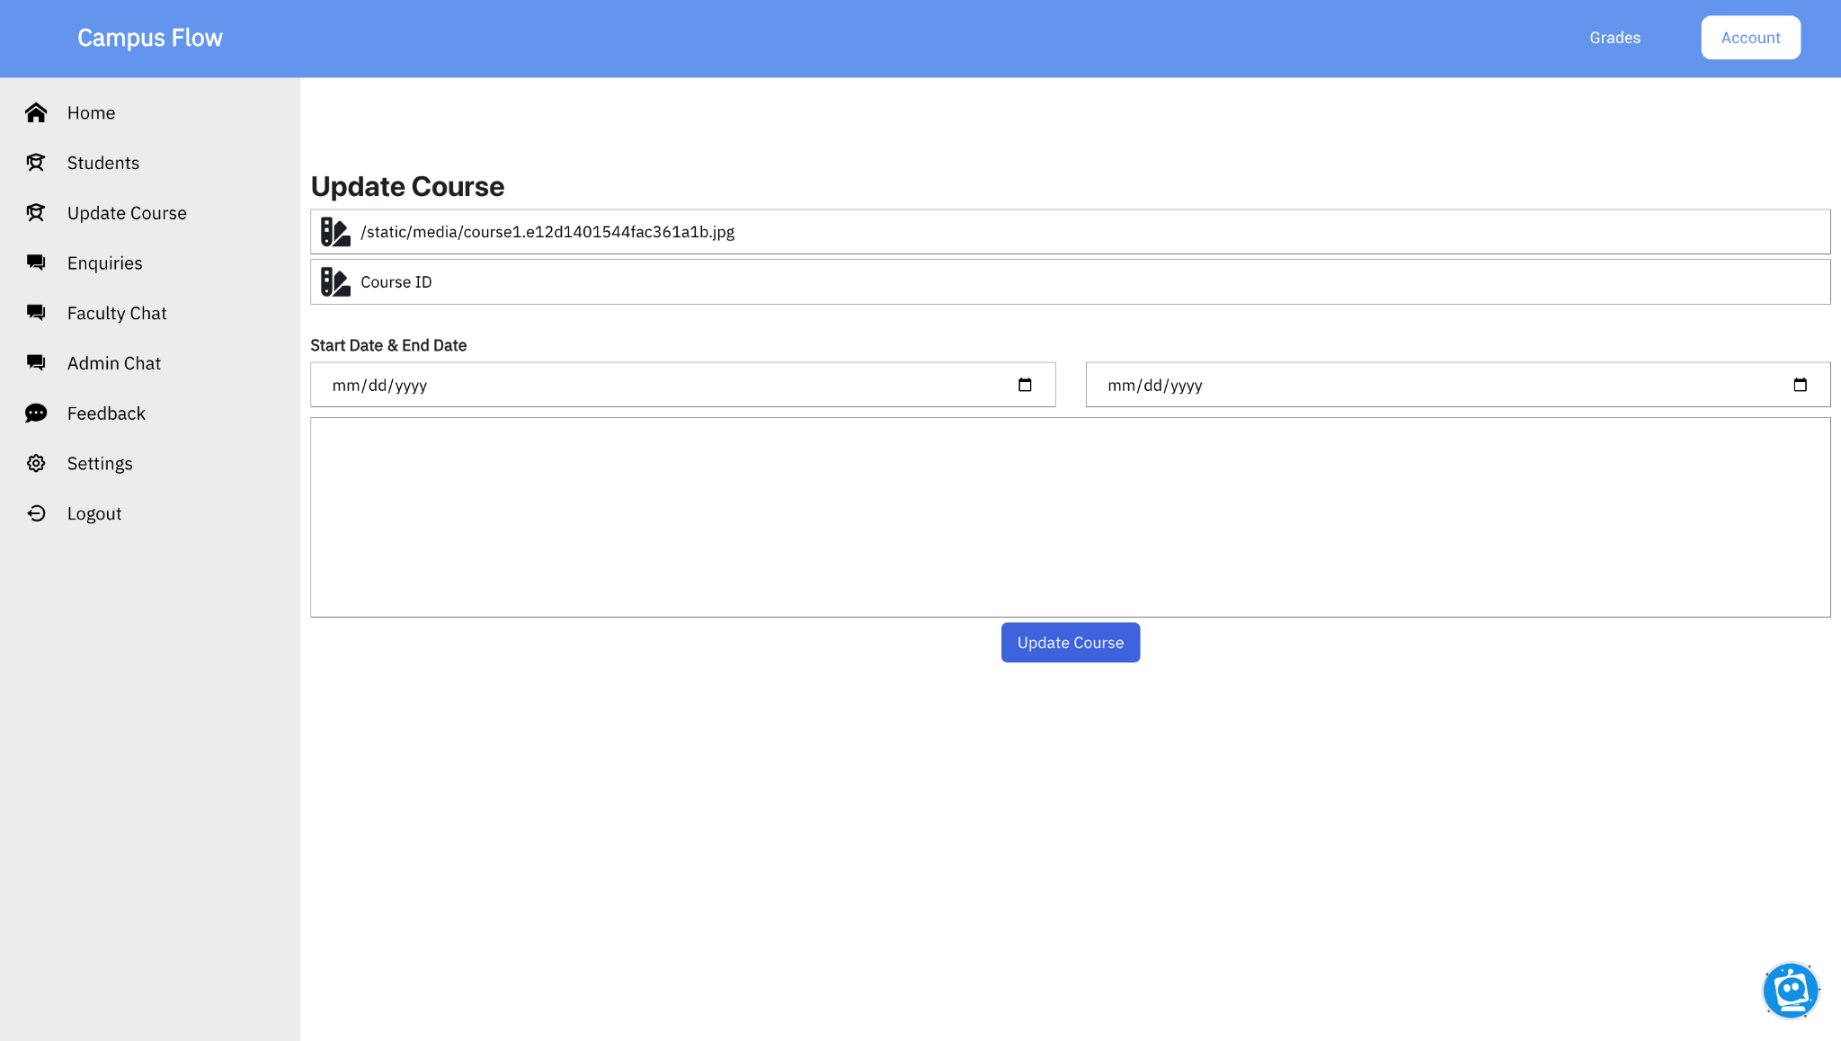
Update Course

Slide 24
Program Coordinator Page: Nurturing Academic Excellence in Campus Flow
Comprehensive Student Oversight
Performance Analysis and Feedback Forms
Course Detail Management
Chatbot for Efficient Communication

Slide 25
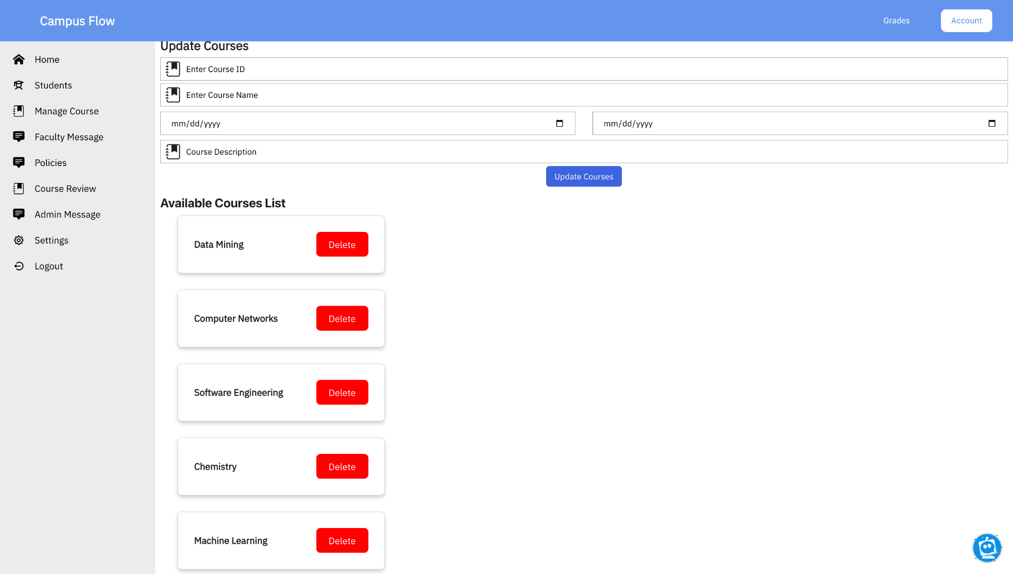
Manage Courses

Slide 26
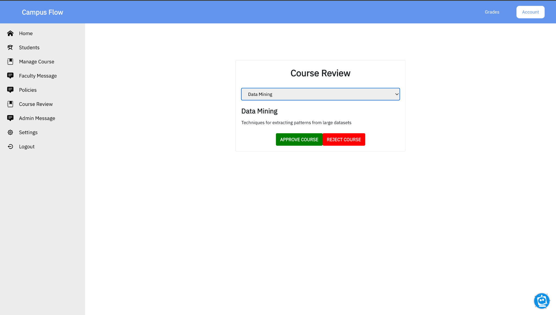
Course Review

Slide 27
Quality Assurance Officer Page: Upholding Standards in Campus Flow
Full Access to Courses
Syllabus Management and Updates
Course Review and Approval Process
Faculty Oversight
Policy Implementation

Slide 28
Node/ Chat

Slide 29
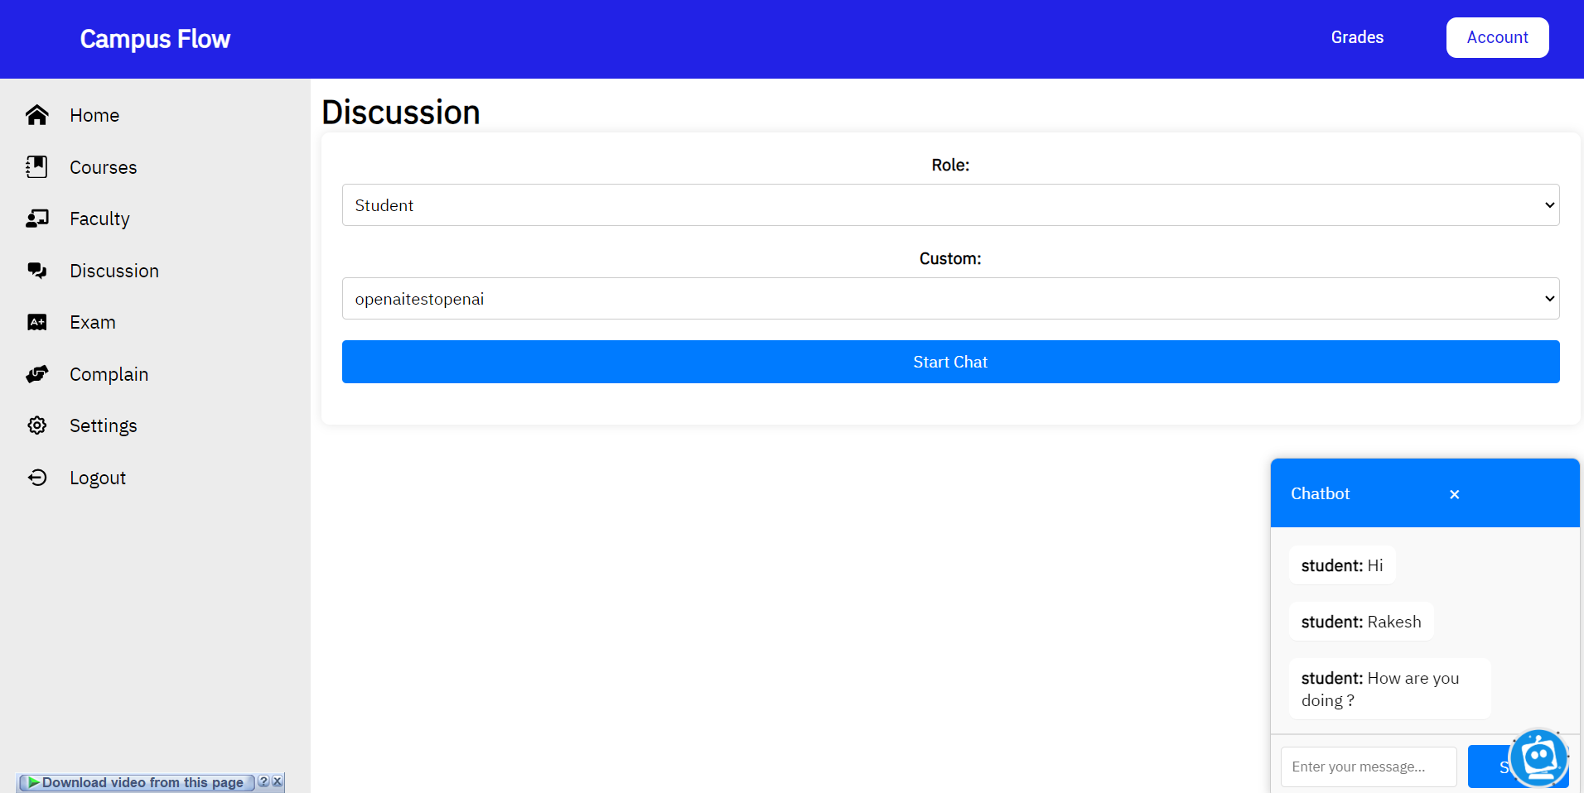
Chatbot Implementation

Slide 30
Chatbot Implementation: Seamless User Communication in Campus Flow
Intra-Platform Communication
User-Friendly Interface
Private and Secure
Efficient Communication

Slide 31
Challenges
Scalability
Data Security and Privacy
Integration Complexity
User Training and Adoption
Quality Assurance
Content Management
Technical Support and Issue Resolution
User Engagement
Accessibility and Inclusivity

Slide 32
Creative Functionalities in Campus Flow
Automated Exam Generation with AI
Personalized Feedback Forms
Intra-Platform Chatbot
AI-Powered Student Recommendations:
Role-Based User Management

Slide 33
Improvement
Continuous AI Refinement:
Campus Flow can benefit from continuous refinement and training of its AI algorithms to enhance the accuracy and relevance of recommendations. Regular updates and feedback analysis can lead to more precise study material suggestions for students.
User Feedback Integration:
Implementing a robust system to collect user feedback and suggestions can drive platform improvements. Actively seeking and incorporating user input into feature enhancements and updates ensures that Campus Flow remains user-centric and aligned with user needs.

Slide 34
Future Portfolio Additions
Emerging Technologies Showcase:
In the coming months, I plan to add projects that showcase my exploration of emerging technologies. This includes developments in fields such as artificial intelligence, blockchain, virtual reality, and more. I aim to demonstrate my adaptability and readiness to embrace cutting-edge innovations.
Industry-Relevant Case Studies:
I will include industry-relevant case studies that delve into real-world challenges and solutions. These case studies will illustrate my problem-solving abilities and practical insights gained from working on impactful projects.
Collaborative Team Projects:
Collaborative teamwork is a crucial aspect of professional growth. I intend to highlight projects where I have worked closely with diverse teams, emphasizing my communication, collaboration, and leadership skills.

Slide 35

Thank You

